Slide 1
Hobby Web Application Project
Nilay Sanghrajka
21/08/2020

Slide 2
Introduction and Scope
Who I am?
What was chosen to do
Why this hobby was chosen

Slide 3
Sprint PLAN
What used
What I need
What I was hoping for

Slide 4
Technologies
Version Control System: Git
Source Code Management: GitHub
Kanban Board: Trello / Jira / GitHub Boards
Back-End Programming Language: Java
API Development Platform: Spring
Front-End Web Technologies: HTML, CSS, JavaScript
Build Tool: Maven
Database Management System: GCP instance of MySQL Server 5.7
Unit Testing: JUnit, Mockito
Static Analysis: SonarQube
Test Reporting: Surefire
Artefact Repository: Nexus
CI Server: Jenkins

Slide 5
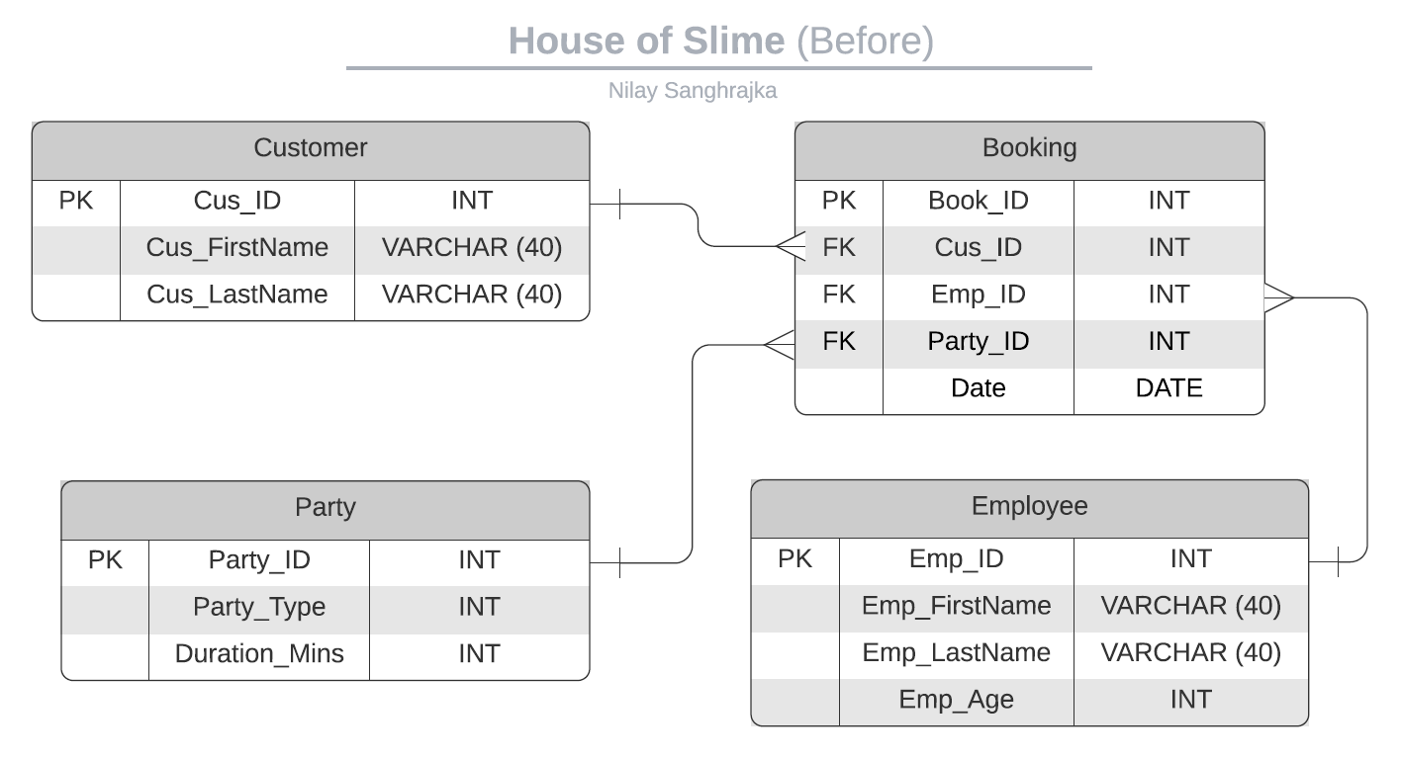
ERD Diagram

Slide 6
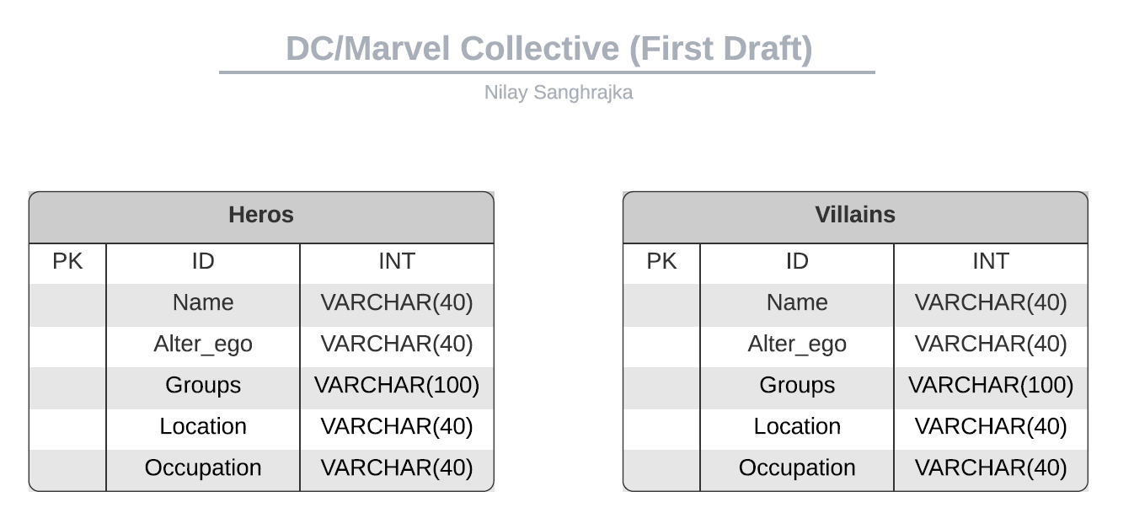
ERD Diagram

Slide 7
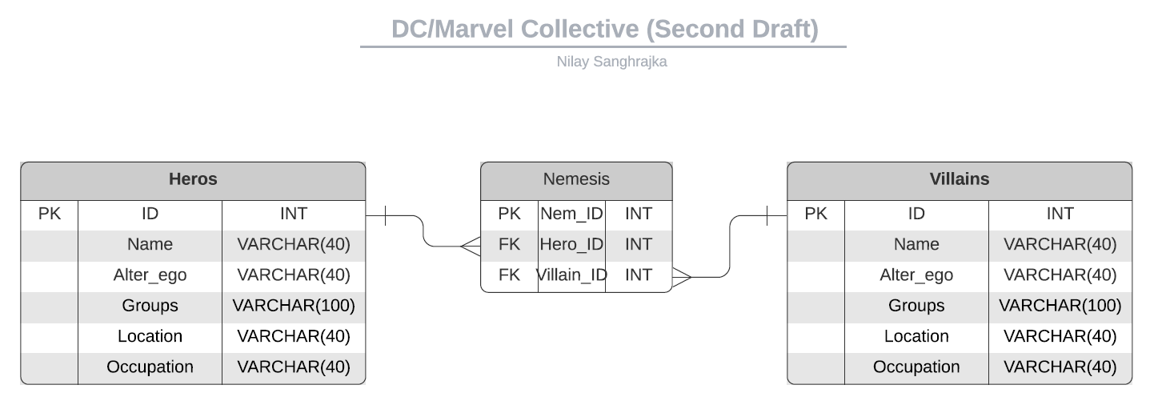
ERD Diagram

Slide 8
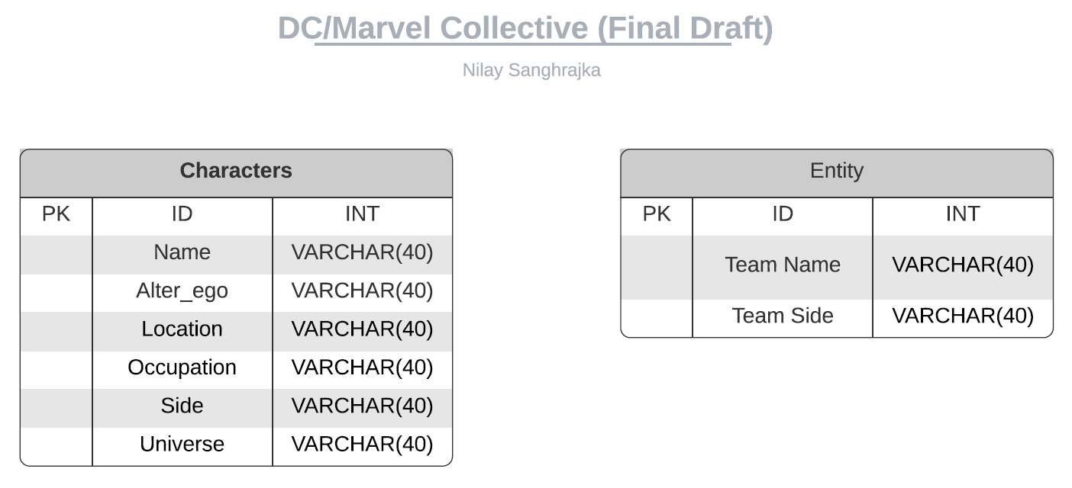
ERD Diagram

Slide 9
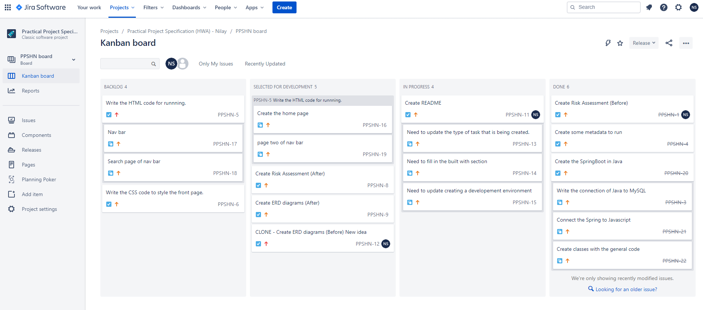
Set Up

Slide 10
TEsting

Slide 11

demonstration

Slide 12

SPRINT REVIEW
What was completed
What was left behind

Slide 13

SPRINT Retrospective

Slide 14

Conculsion

